Slide 1


CHARACTER RECOGNITION USING CNN
NAME : M.R.Janani
COLLEGE : Panimalar Institute of Technology
DEPT : B tech-AI&DS
REG NO : 211521243071
EMAIL : jananijan2114@gmail.com

Slide 2
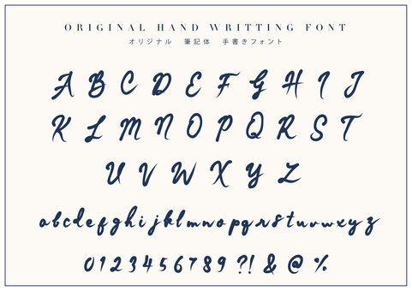
CHARACTER RECOGNITION USING CNN

Slide 3
AGENDA
Problem statement
Proposed system
System development approach
Algorithm & deployment
Result
conclusion

Slide 4

PROBLEM STATEMENT
The technique for converting a text image into a machine-readable text format is called optical character recognition, or OCR. The computer saves the scan as a digital file, for example if you scan a form or receipt.CNN is used recognize the character easily.Characters in the image can be successfully recognised with the CNN classifier. Traditional CNN classifier architecture consists of fully connected layers after a soft-max layer for classification, and convolutional layers for obtaining features.

Slide 5
PROJECT OVERVIEW
Character recognition analyses characters in images or communications.Character recognition uses CNNs' the ability to effortlessly acquire structural traits from raw pixel opinions. CNNs uses convolutional layers to extract image features as well as fully connected layers to classify. CNNs learn character labels off input images via backpropagation and optimisation methods. CNNs be suitable for OCR and document analysis due to the fact that they can accurately classify character in new images upon train.

Slide 6

WHO ARE THE END USERS
Businesses and Corporations
Educational Institutions
Government Agencies
Publishing and Media Companies
Retailers and E-commerce Platforms
Healthcare Providers
Individual Users

Slide 7

YOUR SOLUTION & ITS VALUE PROPOSITION
CNNs excel at character recognition due to their ability to learn sophisticated visual patterns and spatial correlations.CNNs are quick and scalable, making them excellent for real-time and vast data sets. CNNs perform well in many circumstances regardless character appearance changes such fonts, sizes, and orientations.

Slide 8
WOW IN YOUR SOLUTION
Traditional feature engineering has been superseded by CNNs, who intelligently learn valuable characteristics from raw pixel data.CNNs identify local trends and spatial dependencies essential to character recognition that traditional methods can overlook.CNNs are translation-invariant, so they can recognise characters no matter their position or orientation in the image.CNNs handle character appearance differences such font types, measurements, and noise far better than older gets nearer, making them able to survive in real-world circumstances.

Slide 9
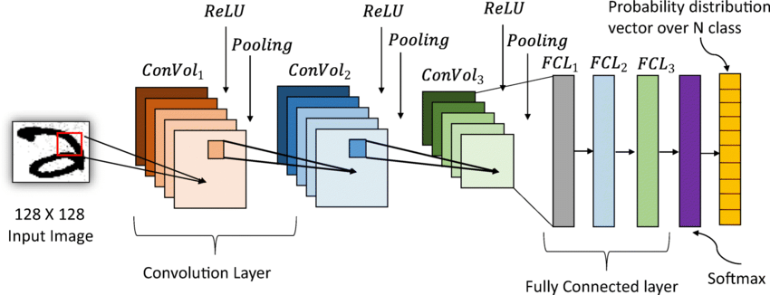
MODELLING

Slide 10

RESULT
CNN-trained neural networks automatically learn character assets from pics. CNNs contain convolutional feature extraction layers and fully corresponding classification layers. The network utilises optimisation strategies to correlate input images to character labels during training. For OCR and document analysis, the CNN can precisely recognise characters in unknown pictures upon training.So, the using CNN for Character recognition is easy and beneficial

